Slide 1
CUpY VS. NUMPY VS. HPAT

Slide 2




CUPY (Cuda python)
A package:
numpy alike, only over GPU

Slide 3
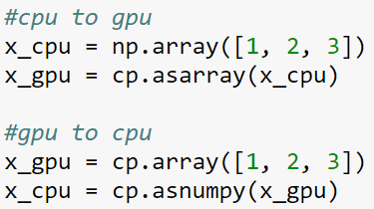
CUPY - converting

Slide 4

CUPY - generic writing

Slide 5
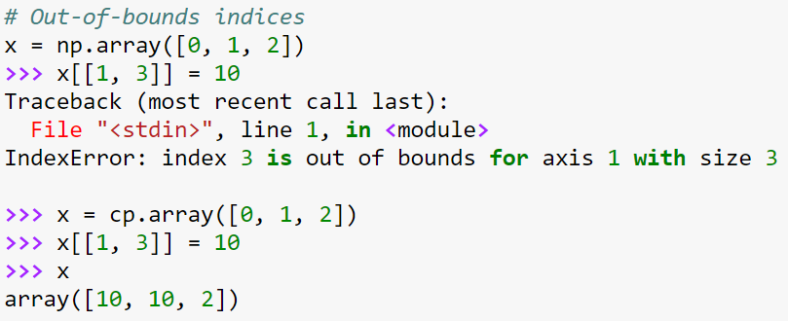
CUPY - DIFFERENCES

Slide 6
CUPY - DIFFERENCES
cupy re-implemented most of numpy’s functions (~90%)
Important functions not yet re-implemented:
histogram
isin
round

Slide 7

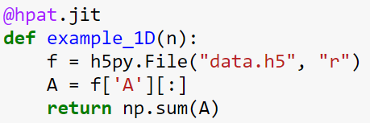
HPAT
A package to decorators:
Adding it makes the ‘.py’ file become parallel (over CPU):

Slide 8
HPAT - numpy
data-parallel numpy operators that hpat can optimize and parallelize:
element-wise operations
reduction functions (sum, min, max …)
array creation (zeros, ones, linspace …)
Random number generator
dot function between a matrix and a vector, or two vectors.
array comprehensions

Slide 9
HPAT - pandas
data-parallel numpy operators that HPAT can optimize and parallelize:
Dataframe creation
Accessing columns
df['A']
Filtering data frames
df[df[‘A’] > 0.5]
Rolling window and shift operations
df.[‘A’].rolling(window=5).mean()
Df[‘A’].shift(1)

Slide 10
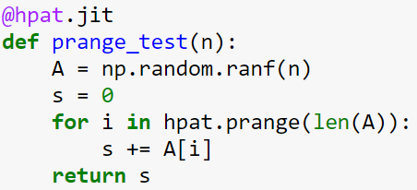
HPAT - loops
If user knows the loop can be parallelized, just switch to hpat.prange:

Slide 11
conclusions
Have GPU? Move to cupy!
import cupy as np
Have small programs with supported operations? Use hpat!
Just add @hpat.jit

